Slide 1
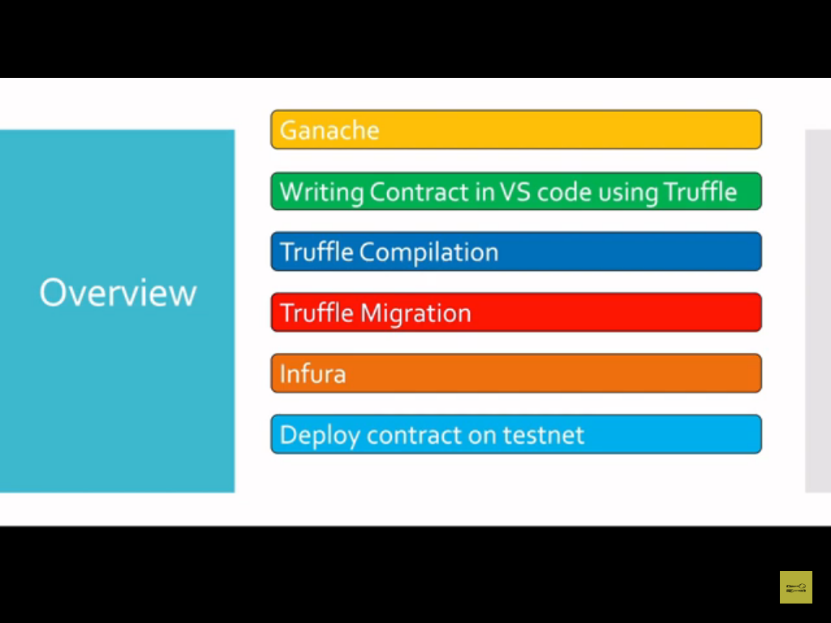

Slide 2
Truffle is a kind of
intermediate level course .
Here we use command line interface(CLI).
In Remix IDE we use GUI.
We have provided the test networks in Remix IDE.

Slide 3
Ethereum Frameworks:-
1)Truffle=>For blockchain that use the Ethereum Virtual Machine (EVM),truffle provides a top-tier development environment ,testing framework.
Its a platform for developing decentralized apps on the Ethereum blockchain.
It is well known and innovative framework.
Due to its configuration being user-friendly for beginners,Truffle is likely to be your first contact ,if you are new to DApps development.
The majority of the other framework adopted Truffle’s approach.
Additionally it is interoperable with other blockchains that support earned value management and compatible EVM blockchain like Binance Smart Chain ,Hyperledger ,Polygons and others.

Slide 4
The languages solidity and vyper are also supported.
Website:https://truffleframework.com
https://www.npmjs.com/package/truffle

Slide 5
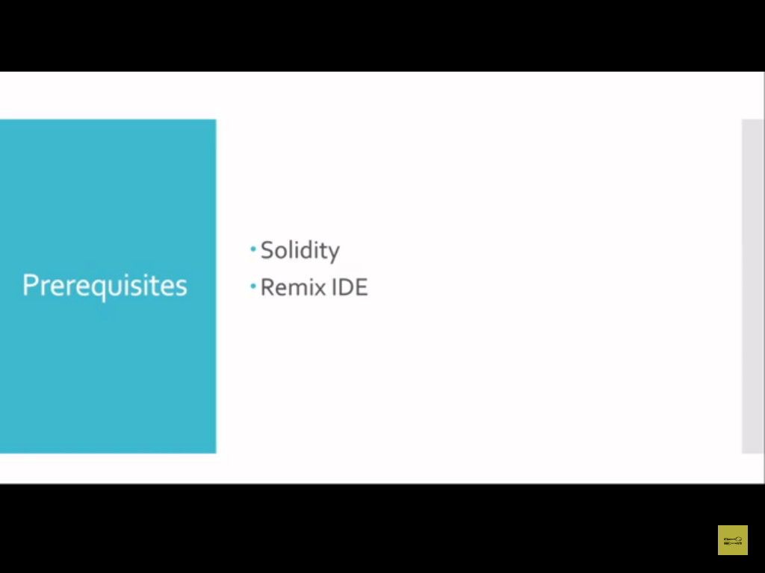

Slide 6
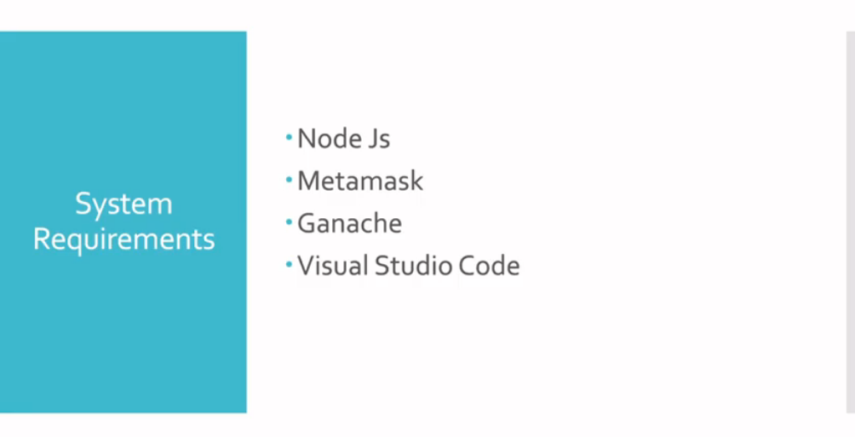

Slide 7
Ganache is a local blockchain simulator .
We can create a local blockchain or personal blockchain using Ganache.
Ganache provides the fake ether and addresses.

Slide 8
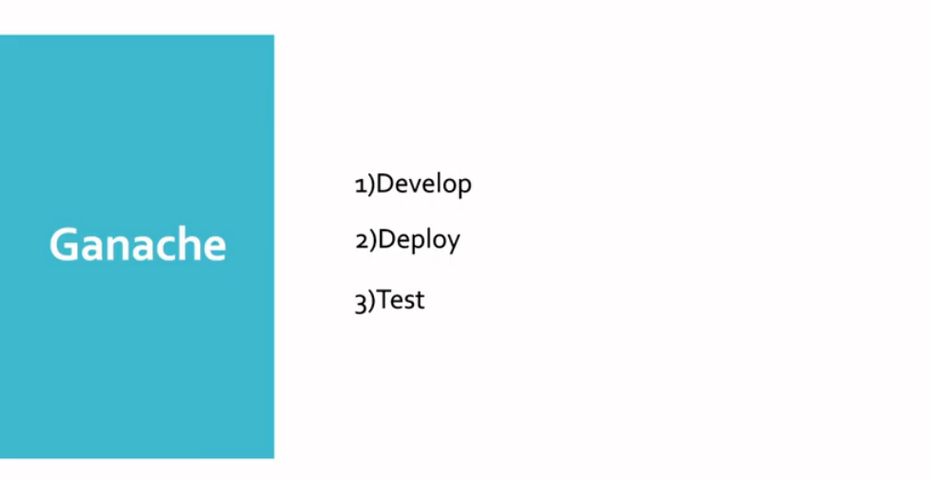

Slide 9
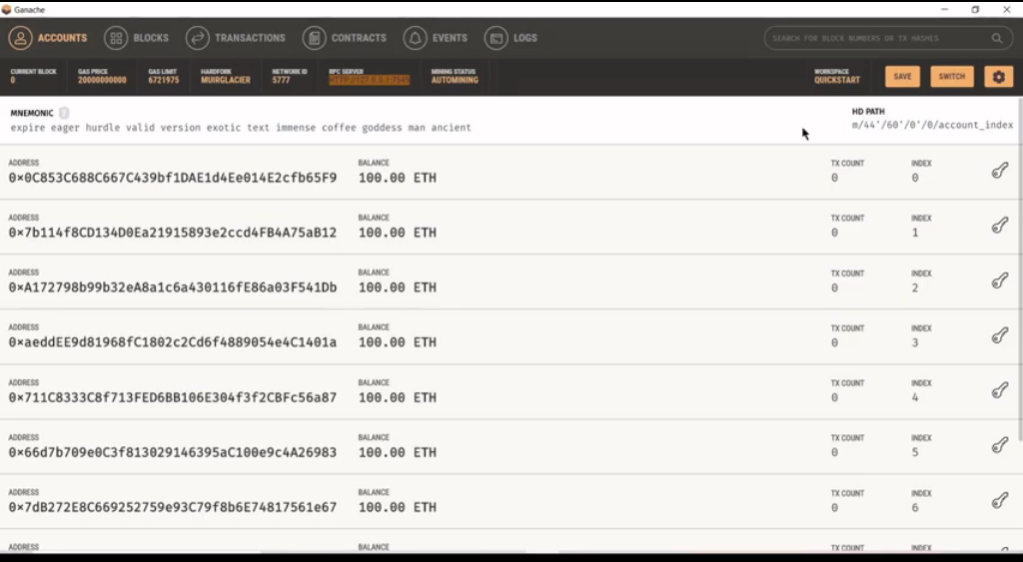

Slide 10
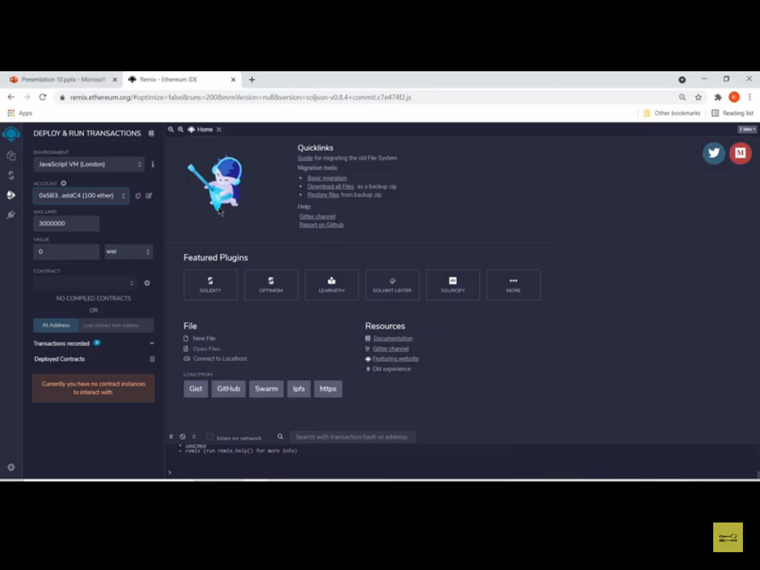

Slide 11
Remix IDE provides the GUI interface.But it is good at beginner level programming.
If you want to create small decentralized application then you can go with Remix-IDE.
In Remix IDE we can use only solidity programming language.
Truffle uses Ganache for deployment.

Slide 12
Truffle is a development environment/framework for smart contracts, and Remix is an IDE in the browser.
They both provide the ability to test and deploy contracts, but truffle can be included in projects as a build dependency, whereas remix contains an editor.
We can use truffle when building javascript projects based on smart contracts (e.g. Dapps), and use remix for its debugging tools.

Slide 13
https://medium.com/@kacharlabhargav21/using-ganache-with-remix-and-metamask-446fe5748ccf#:~:text=Basically%20Ganache%20runs%20local%20instance,with%20Remix%20IDE%20and%20Metamask.&text=Remix%20IDE%20is%20a%20web,write%20smart%20contracts%20in%20Solidity.

Slide 14
https://remix-ide.readthedocs.io/en/latest/truffle.html

Slide 15
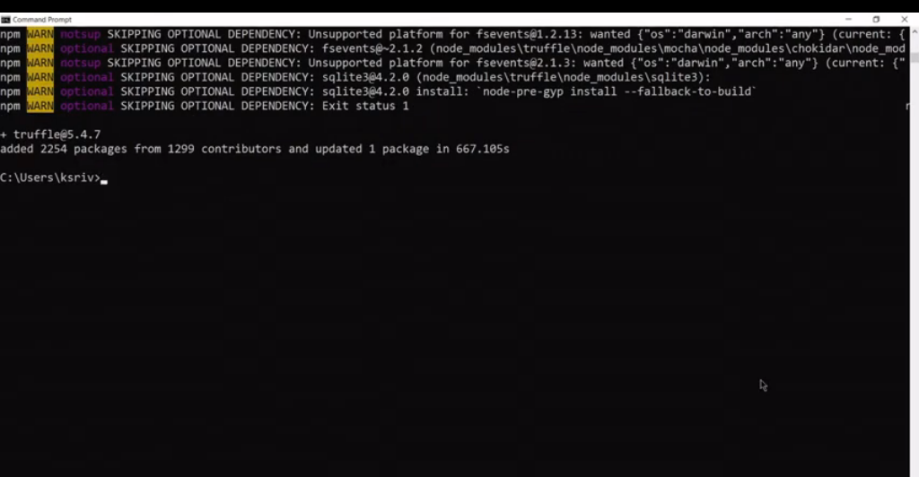

Slide 16
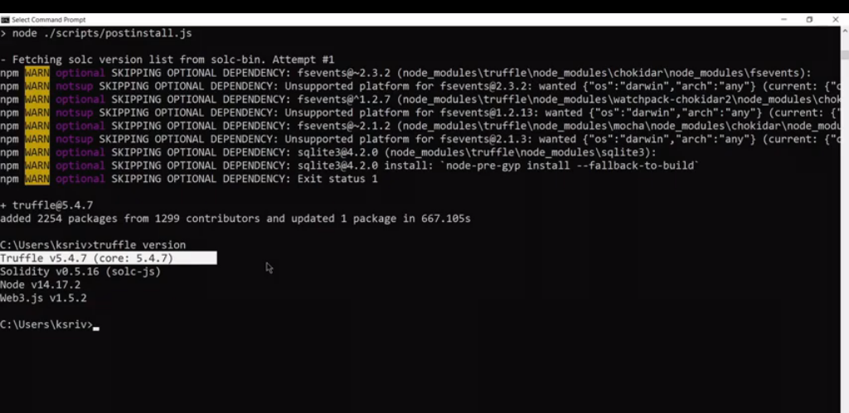

Slide 17
Truffle installation
Node.js must be set up on your computer before you can start .
Installing is simple ;just enter the following command in your project:-
=>npm install -g truffle
=>truffle init
If everything goes well ,you should observe the following
Starting init……

Slide 18
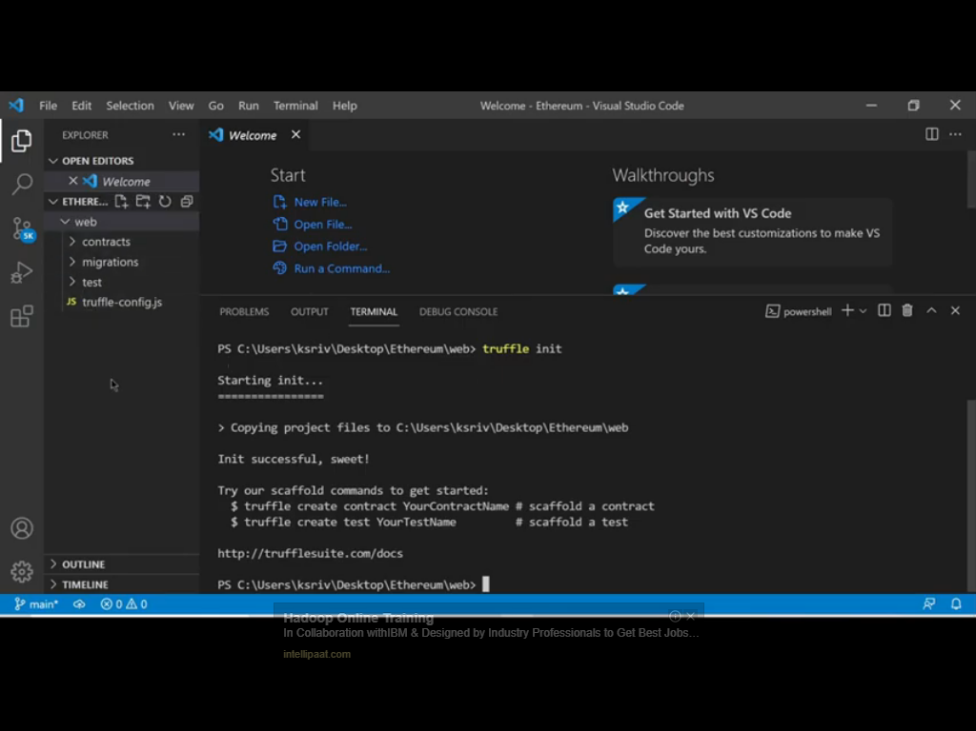

Slide 19
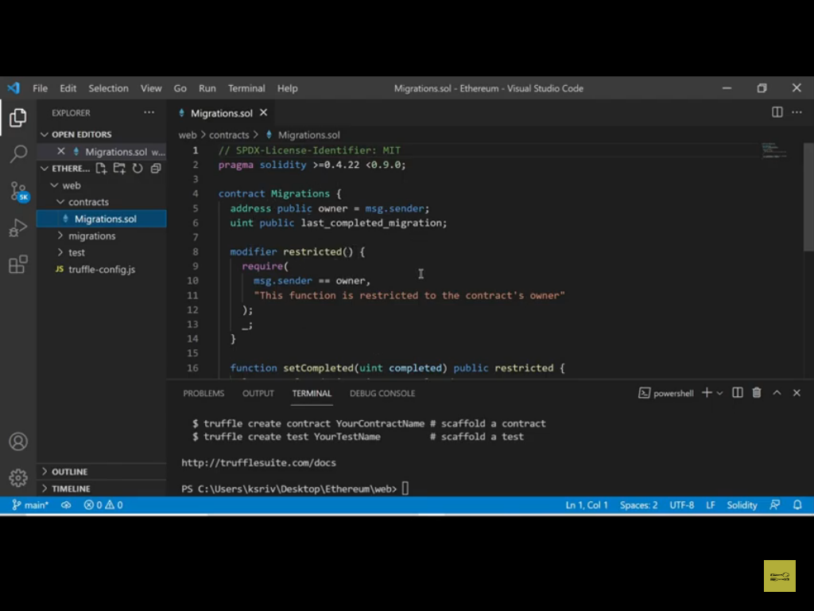

Slide 20
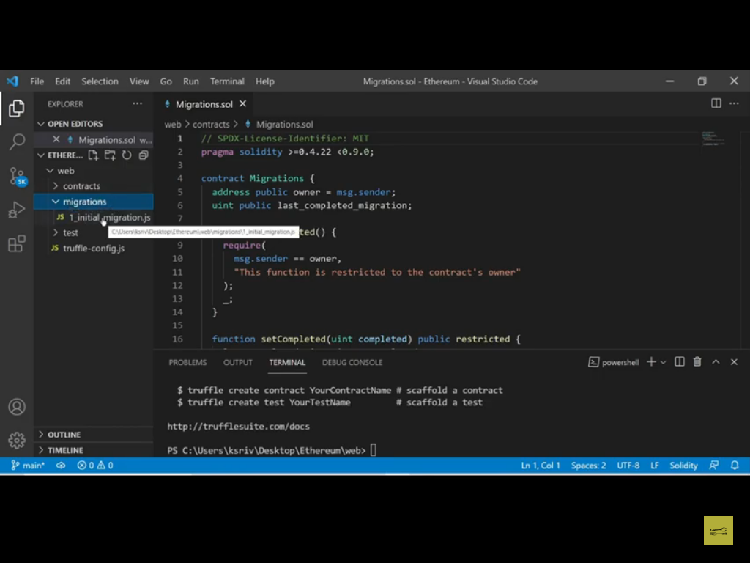

Slide 21
If you want to deploy your smart contract on Ganache that time we use Migration folder.
We are working on Ethereum using solidity programming so testing is required to avoid the attacks.

Slide 22
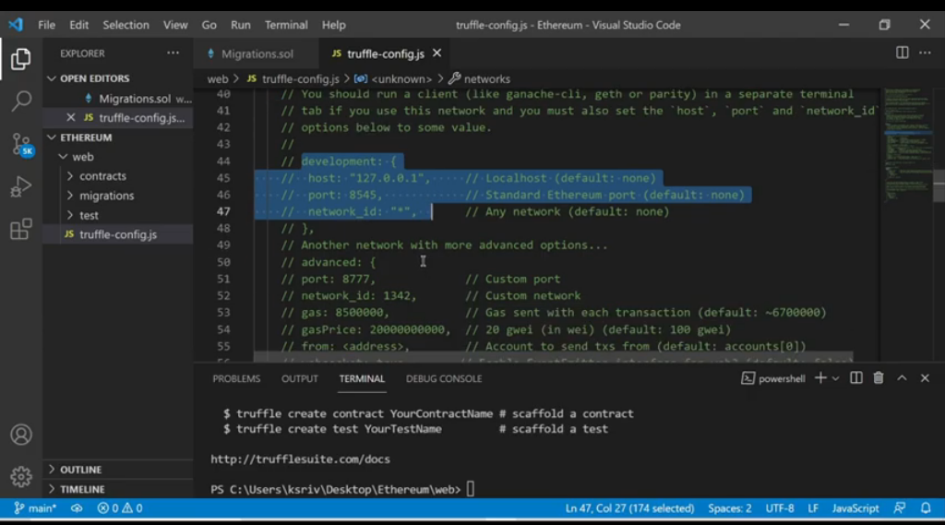

Slide 23
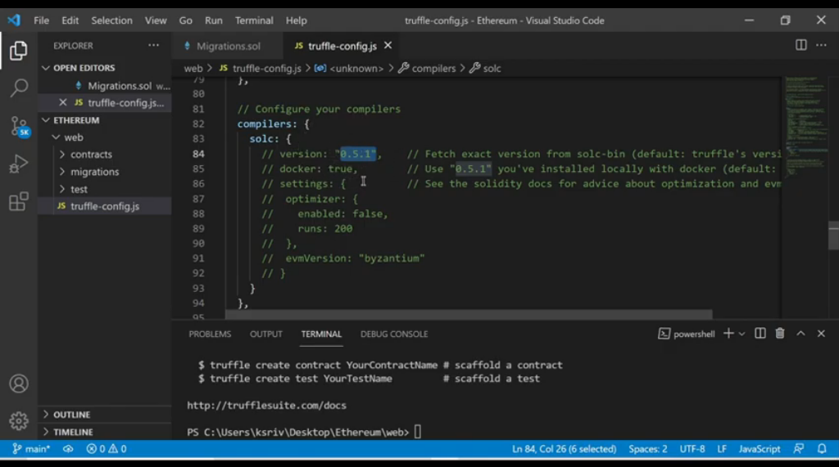

Slide 24
https://trufflesuite.com/docs/truffle/reference/configuration/

Slide 25
https://www.cryptowisser.com/wallet/ethereum-mist-wallet/

Slide 26
Compilation of smart contract using Truffle.

Slide 27
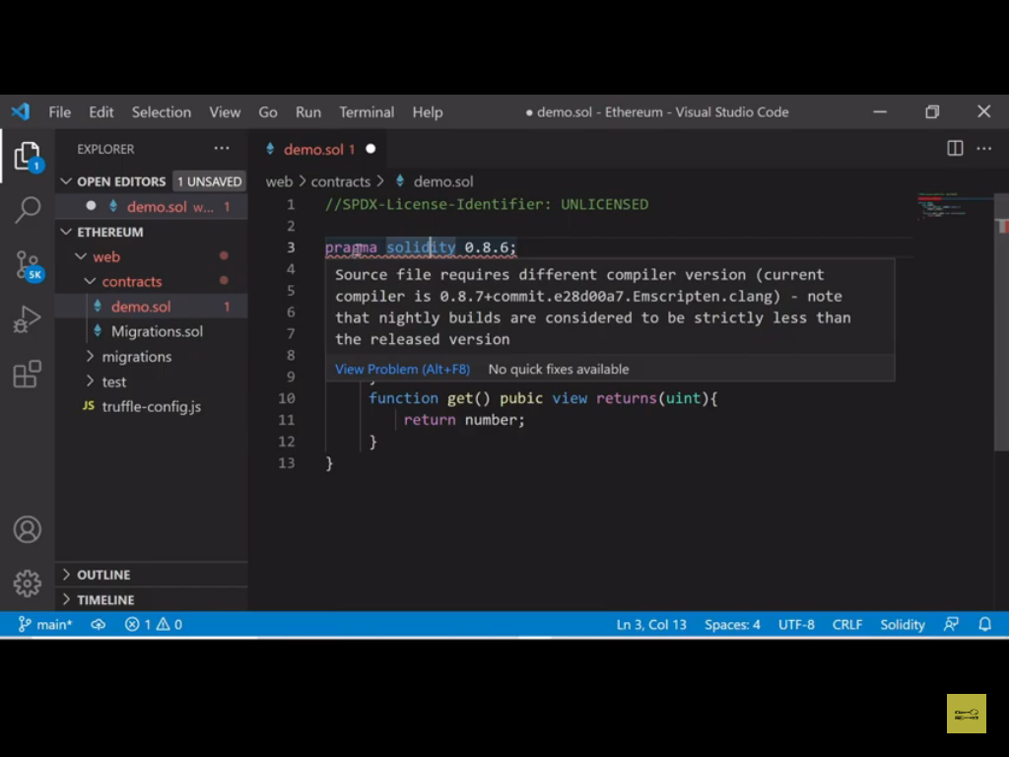

Slide 28
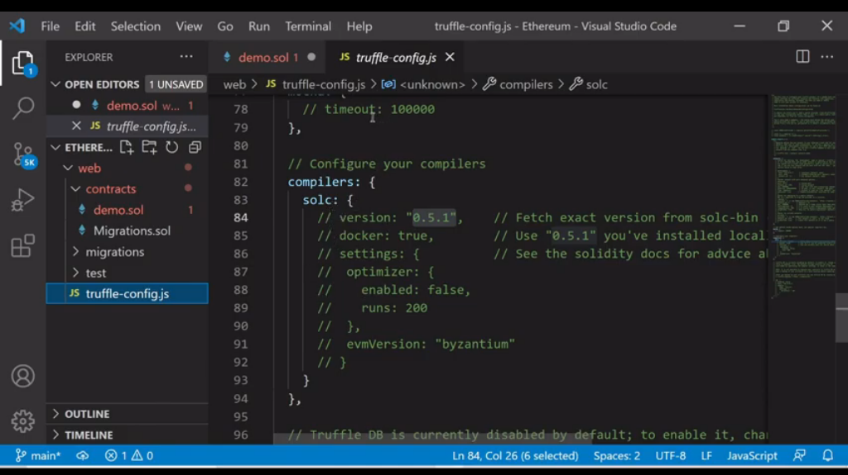

Slide 29
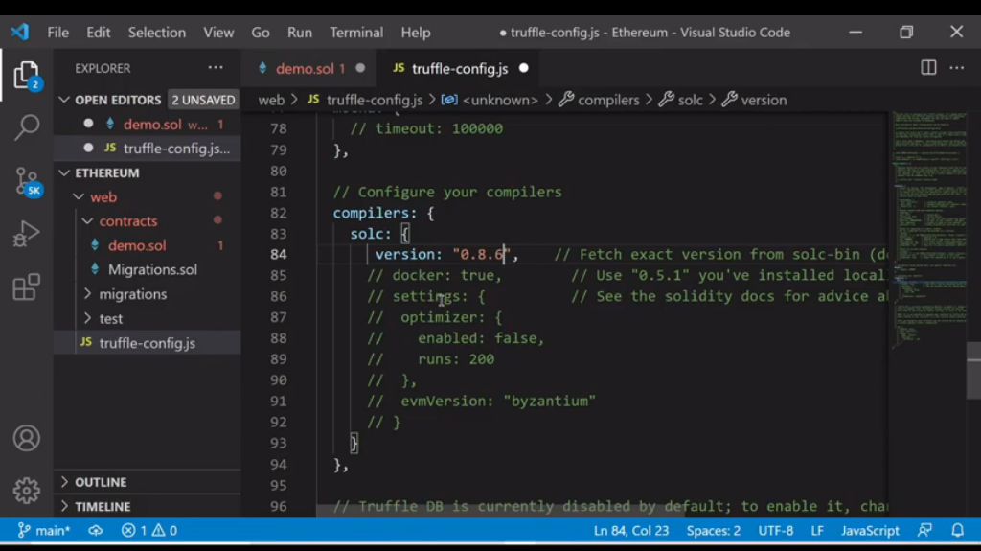

Slide 30
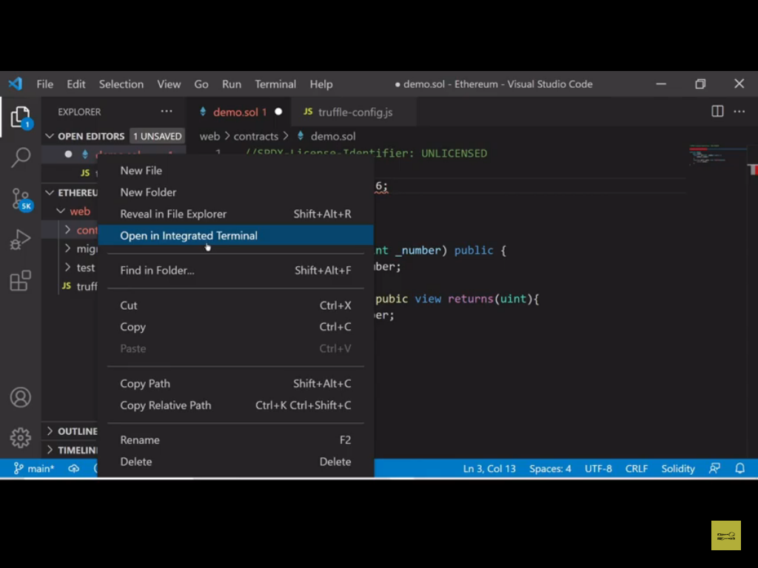

Slide 31
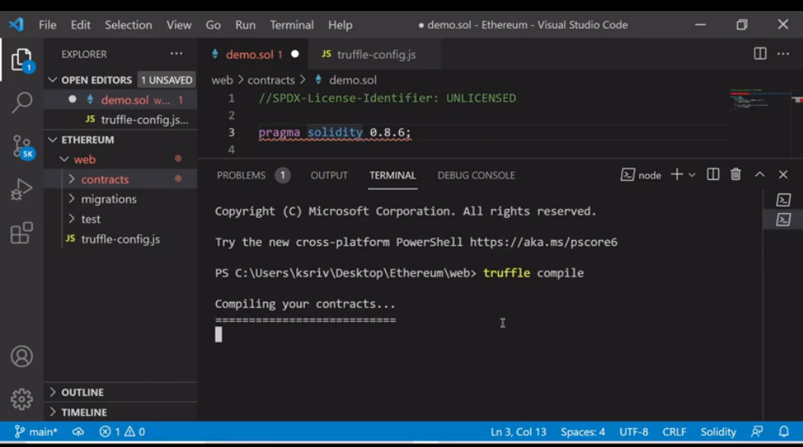

Slide 32
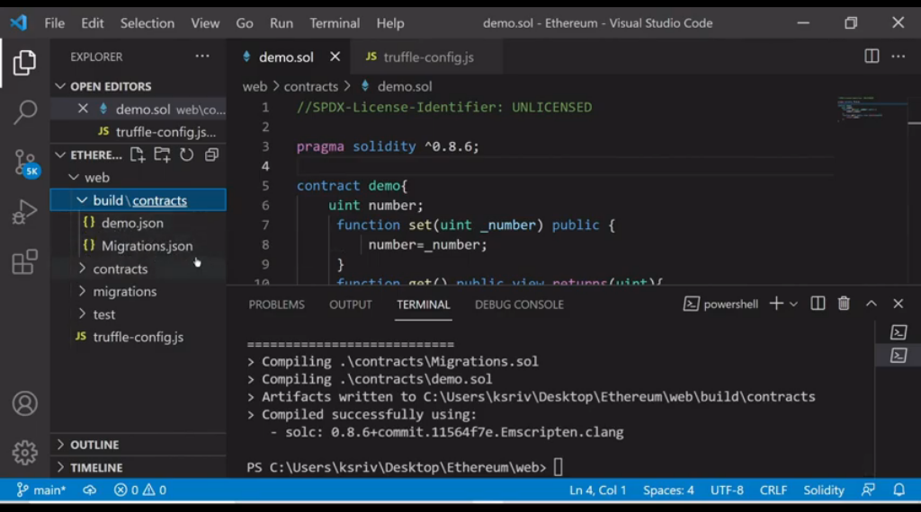

Slide 33
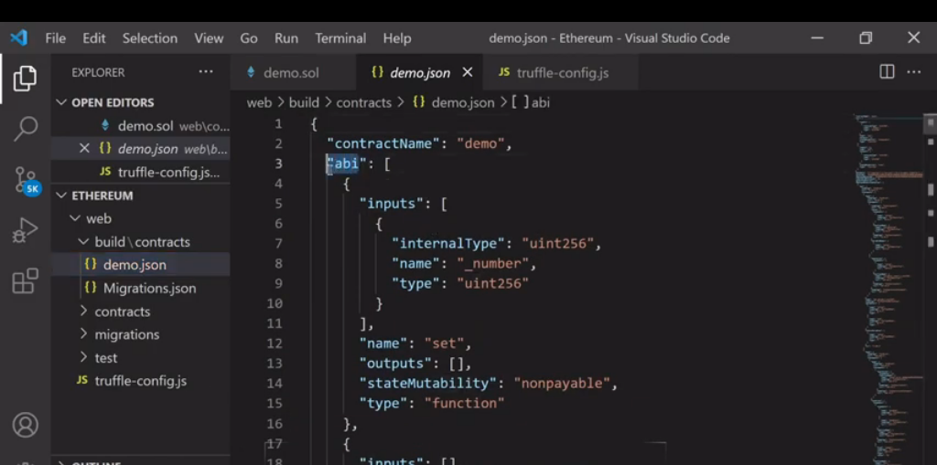

Slide 34
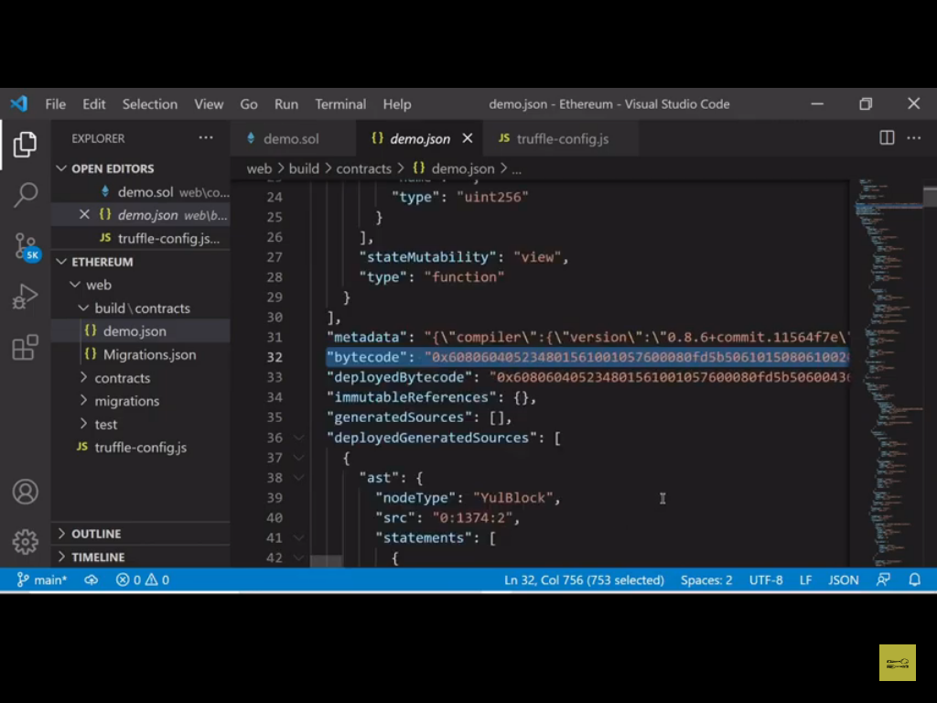

Slide 35
Deployment of smart contract using Ganache
For deployment we talk about the migration folder

Slide 36
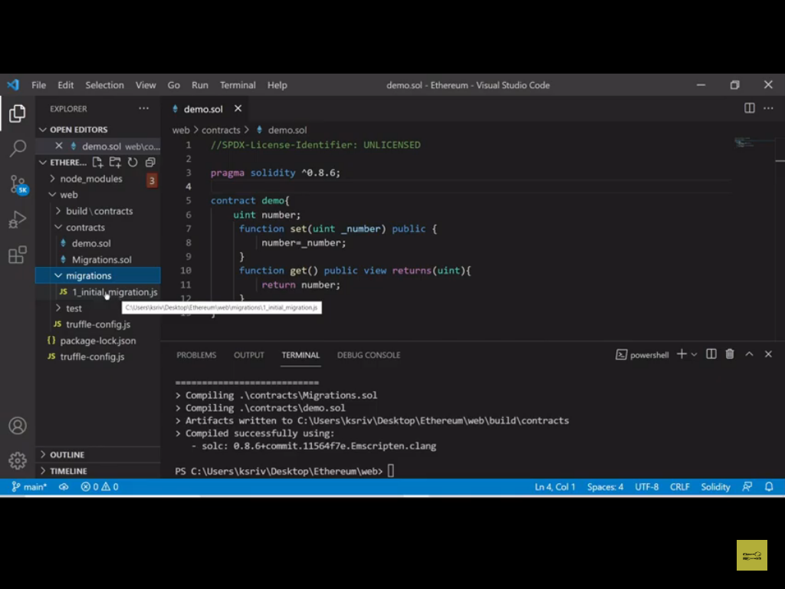

Slide 37
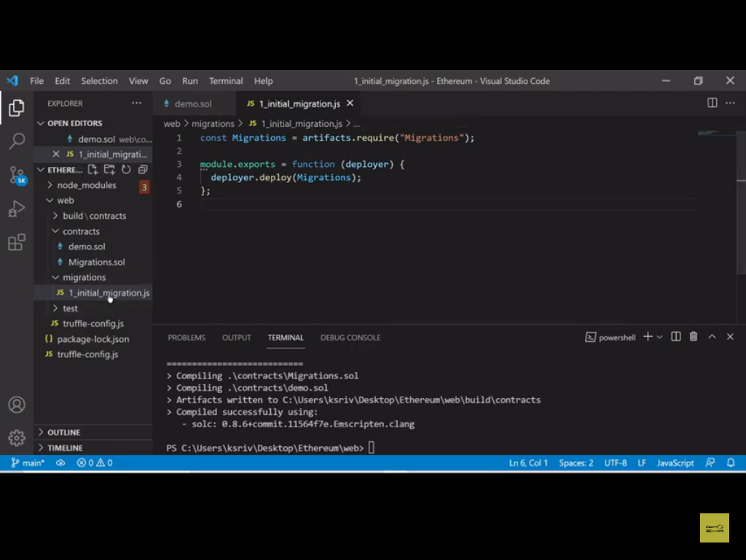

Slide 38
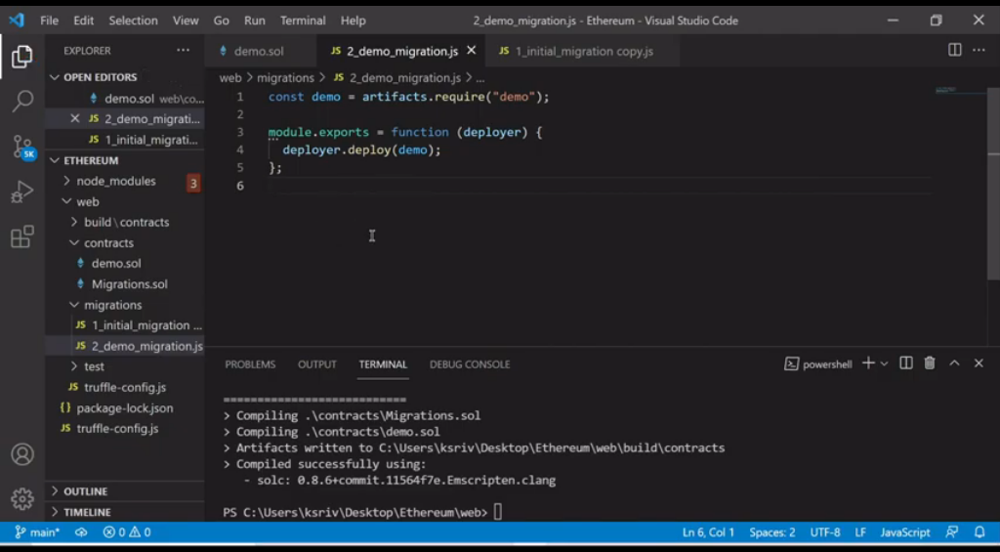

Slide 39
Before deployment of smart contract we need make some changes in the config file=>
In Network section
Port Number:8545 is for Truffle CLI
Port Number:7545 is for Ganache GUI

Slide 40
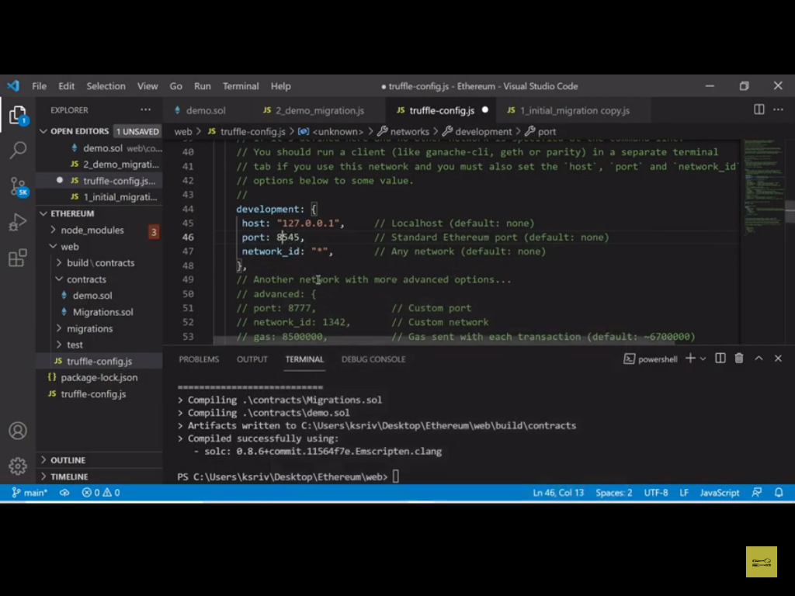

Slide 41
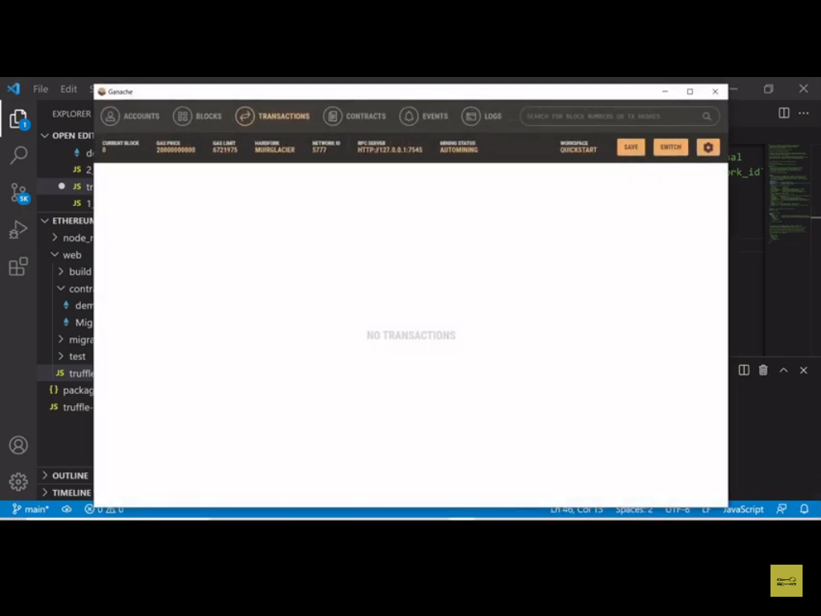

Slide 42
At the time of smart contract deployment make sure that Ganache is on otherwise it will show error.

Slide 43
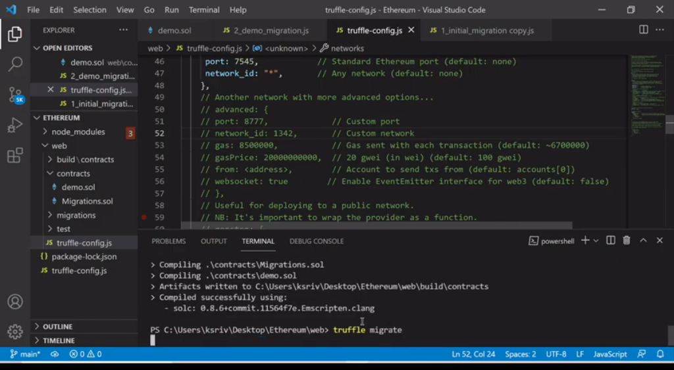

Slide 44
When you migrate the smart contract that time it also compiling the smart contracts as well.

Slide 45
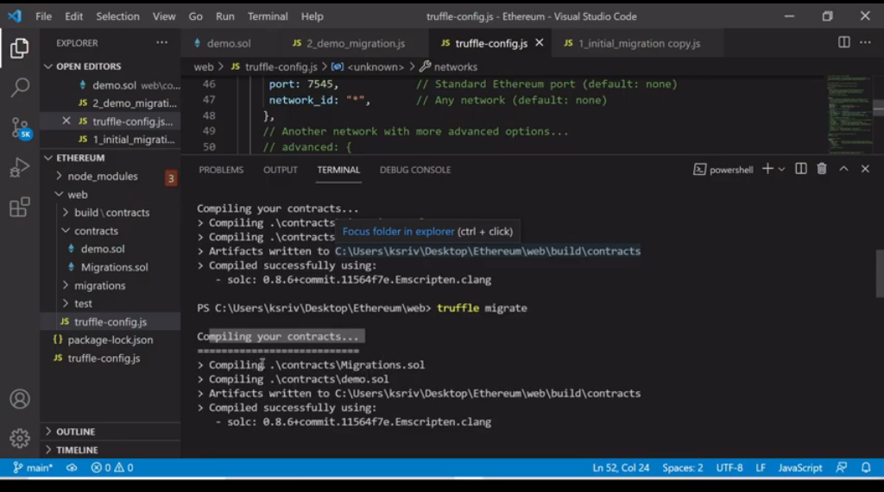

Slide 46
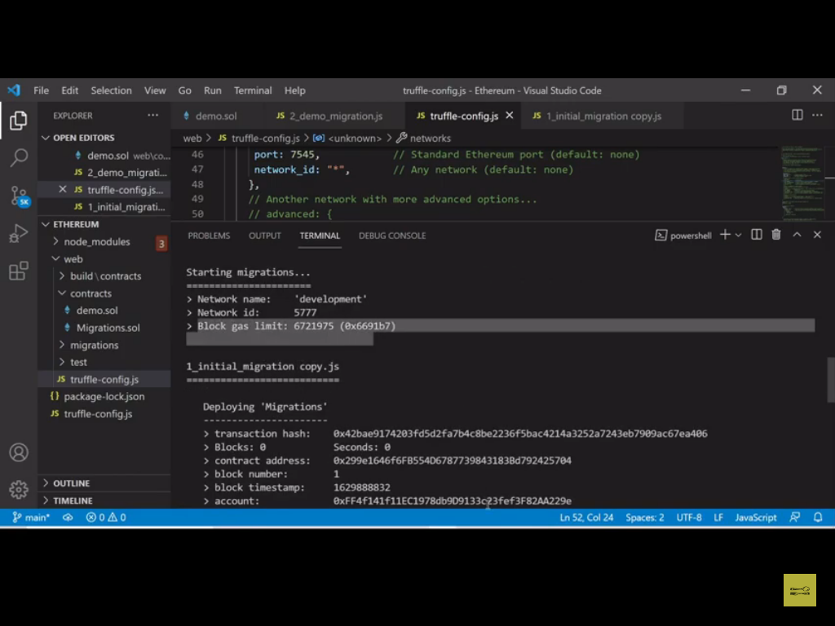

Slide 47
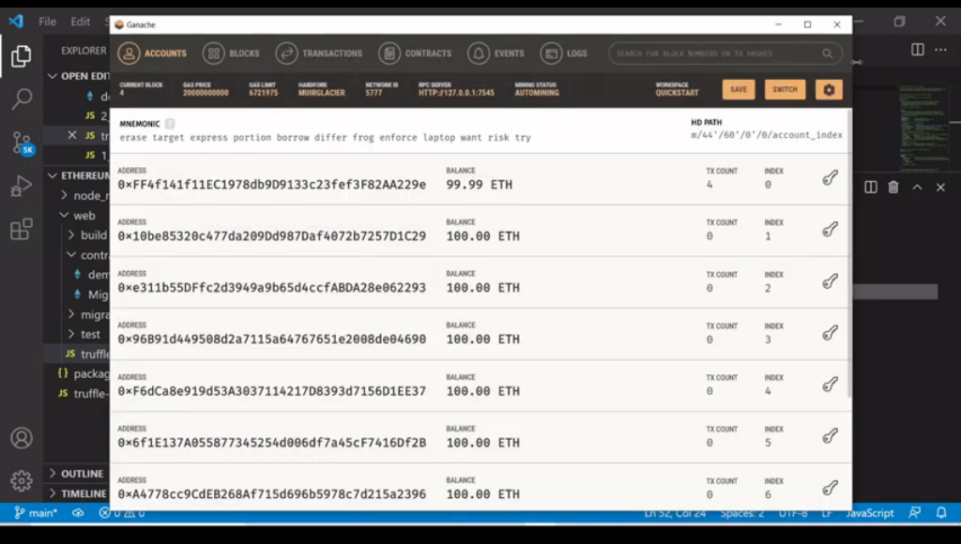

Slide 48
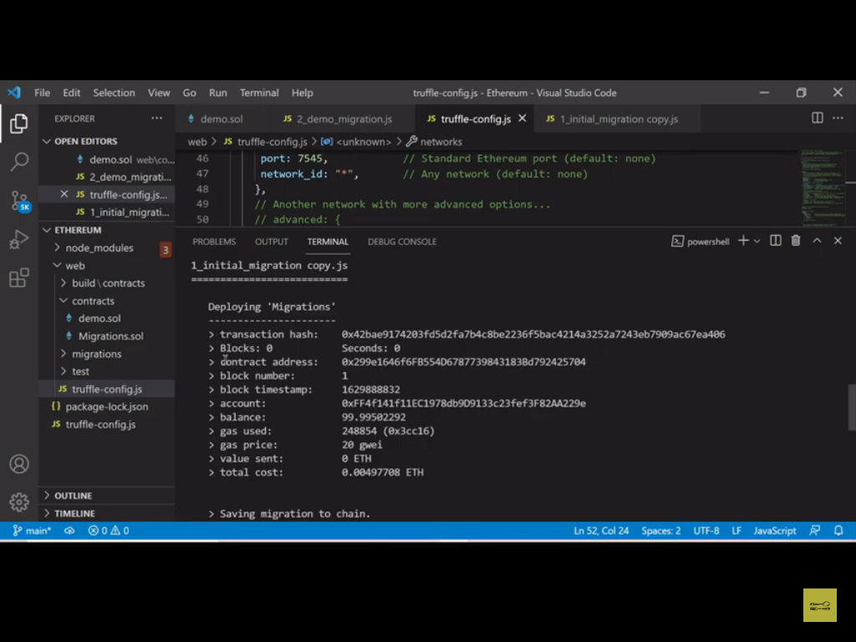

Slide 49
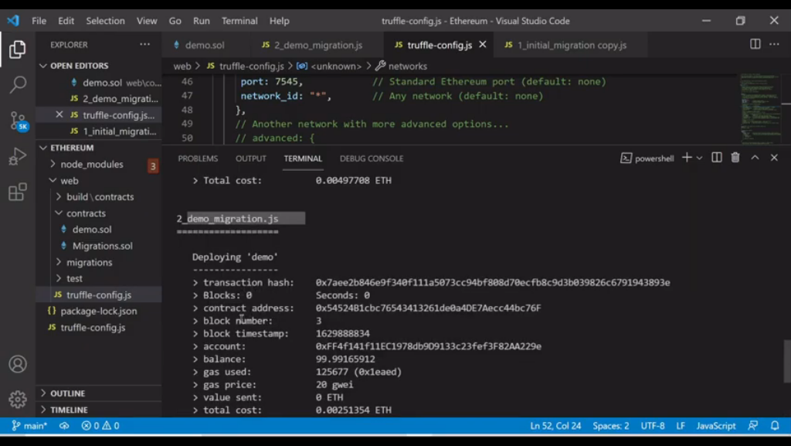

Slide 50
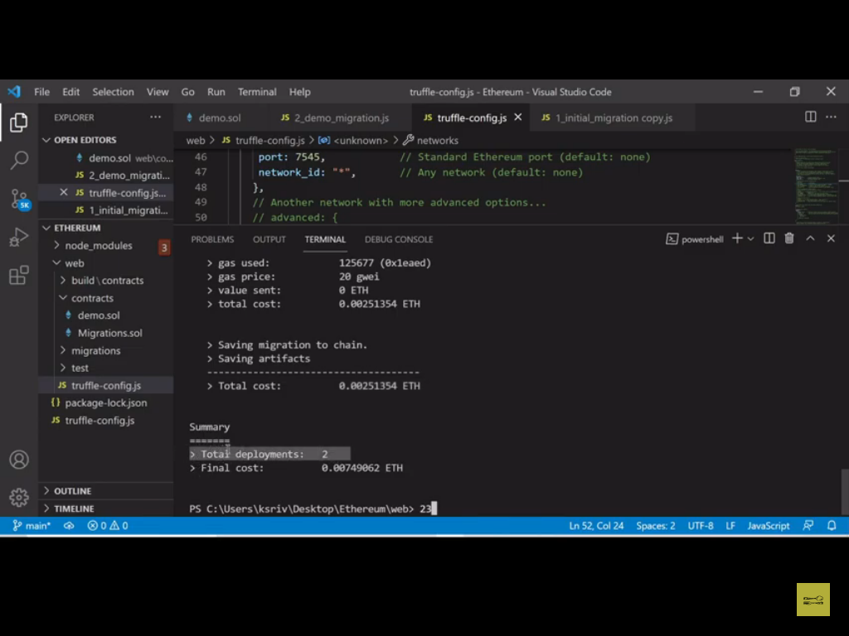

Slide 51
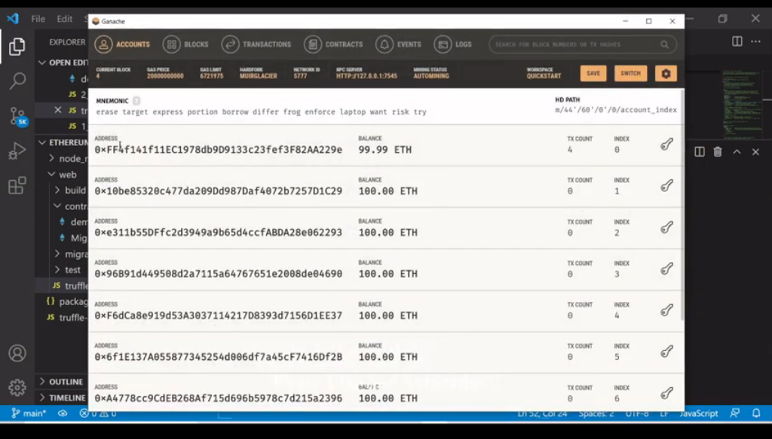

Slide 52
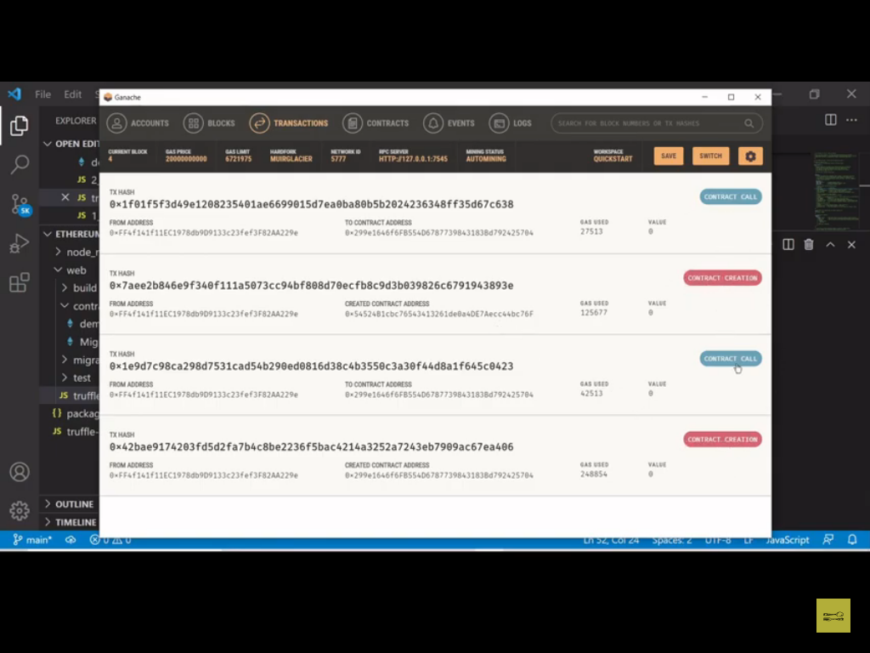

Slide 53
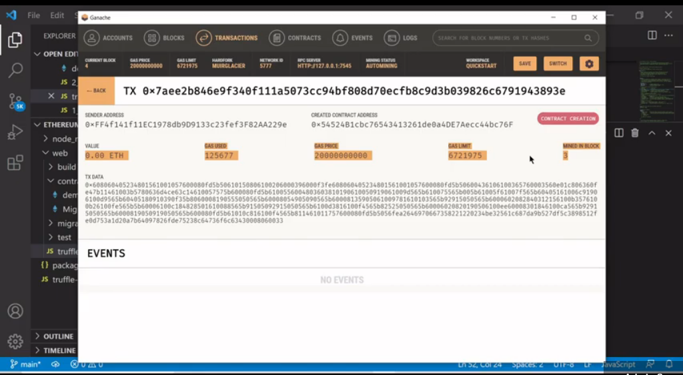

Slide 54
We use Truffle here instead of Web3 which makes the deployment process easier

Slide 55
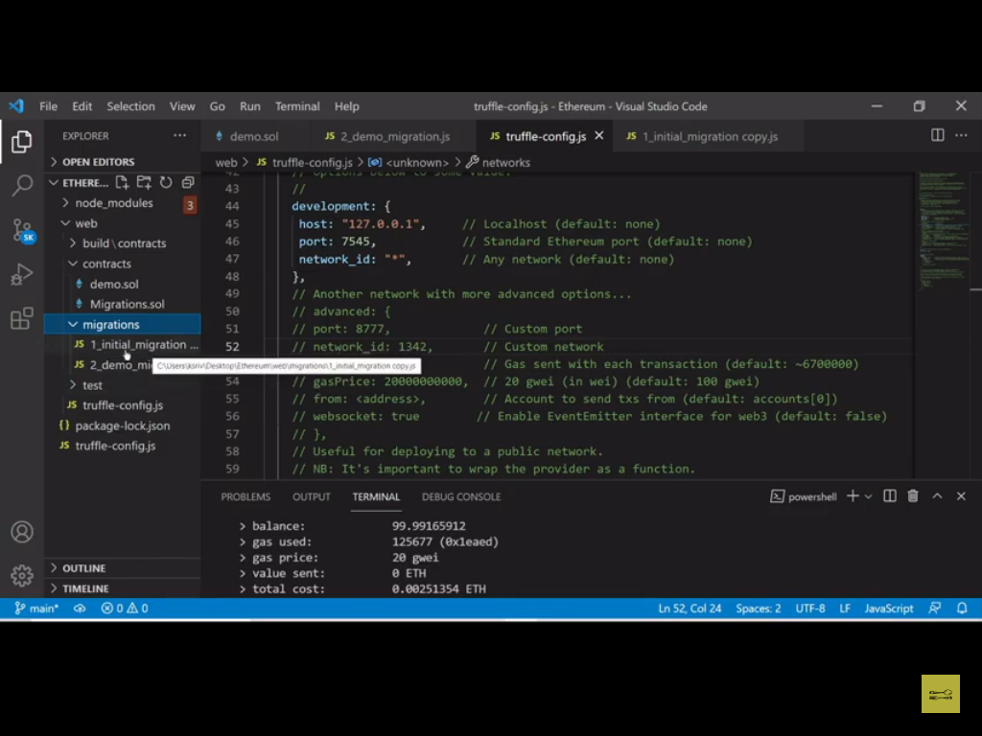

Slide 56
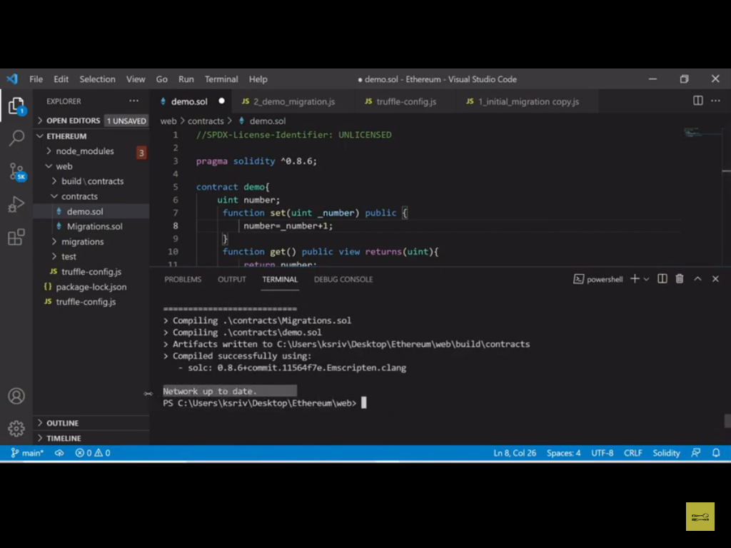

Slide 57
